Slide 2
Financial Training
Setting Goals
Budgeting
Building Credit
Saving
Investing
Banking
Identity Protection

Slide 3
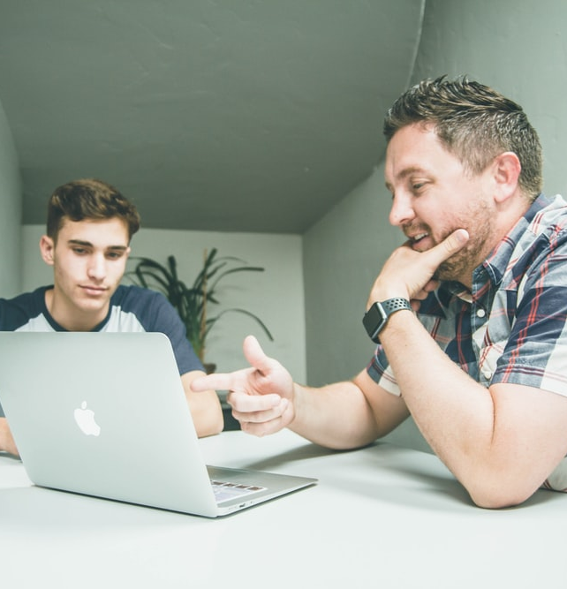
Mentors and Financial Coaches
Ready for Life Mentors
Attend financial training classes
Connect weekly to apply skills learned
Continue to encourage and support post training
United Way Suncoast Financial Coaches
Have a financial background and trained as coaches
Provide individualized advising to reach financial goals

Slide 4
Financial Coaching - Galaxy

Slide 5
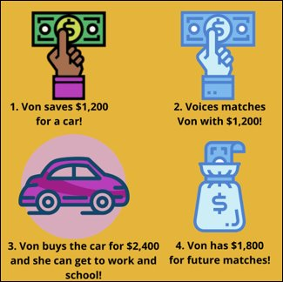
Up to $3,000 Savings Match
Qualified Assets
Vehicle
Housing
Education
Health
Credit building
Small business

Slide 6
Savings Match - Donate

Slide 7
Step Up Loan Program
Up to $2,500
Interest free
3-year term
Self-interest match
To purchase a qualified asset

Slide 8
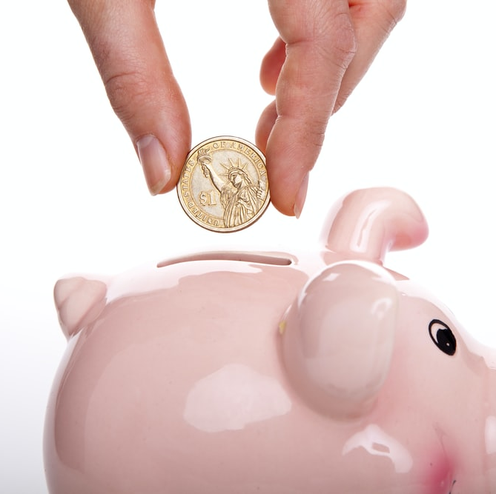
Stipends
Course Completion - $100
Assessments - $40
Surveys - $40
Speaking Engagements - $50

Slide 9
Opportunity Passport Success!
Over 70 graduates so far!
$150,000 in assets purchased!

Slide 10
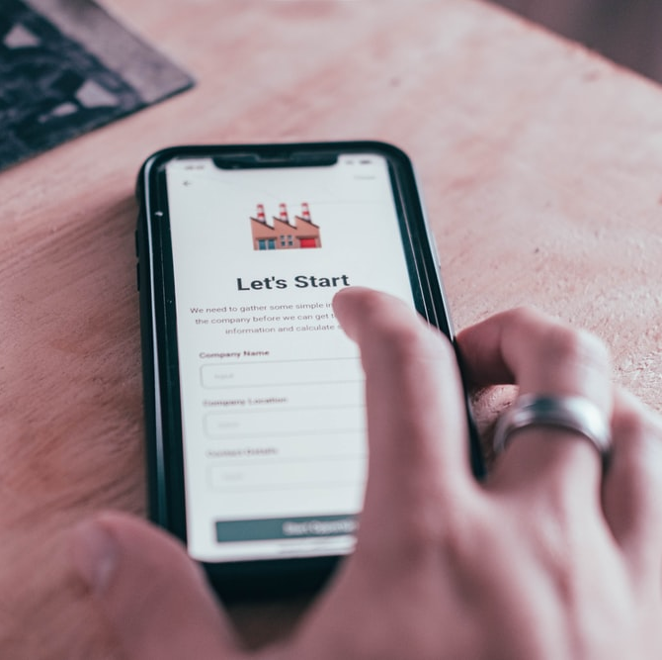
For More Information
suncoastvoices.org/op
op@suncoastvoices.org
Next Class – October!

